Slide 1


COLLECTIONS
Notes:
Hello everyone. Welcome to Aitrich Academy. Today we are discussing about collections.

Slide 2


Overview
Introduction
What is collection?
Non Generic Collections
Notes:
Overview :
In this session we will covering the introductory part , what is collection and its type and different types of non generic collections.

Slide 3

INTRODUCTION
A collection sometimes called a container is simply an object that groups multiple elements into a single unit.
A collection sometimes called a container is simply an object that groups multiple elements into a single unit.
A collection is a kind of data structure.
A collection is a kind of data structure.
A data structure is a way of storing data in a computer so that it can be used efficiently.
A data structure is a way of storing data in a computer so that it can be used efficiently.
A data structure is a way of storing data in a computer so that it can be used efficiently.
Collections can improve code readability and self documentation, as well as enhance maintainability.
Collections can improve code readability and self documentation, as well as enhance maintainability.
Collections can improve code readability and self documentation, as well as enhance maintainability.
C# Collection classes are defined as part of the System.Collections
Notes:
Introduction :
let's continue our journey into the world of collections.
Imagine collections as virtual organizers inside your computer. These organizers help keep different pieces of information in order, like having separate drawers for your toys, clothes, and snacks.
Let's say we have a collection for our favorite snacks. Instead of scattering them all over the place, we gather them in one special snack box. It's easier to find what we want, right?
Well, collections in computers work similarly. They keep our information organized, making it easy for the computer to find things quickly.
In the programming language C#, we have these cool pre-built organizers called Collection Classes. They're like ready-made boxes for our data. So, just like our snack box, they make handling information a piece of cake. Today, we'll see how these digital organizers can make our computer adventures even more exciting. Let's jump right in!

Slide 4
TYPES OF COLLECTIONS IN .NET
Non Generic
ArrayList
Hashtable
SortedList
Queue
Stack
Generics
List<T>
Dictionary<TKey,TValue>
SortedList<TKey,TValue>
Queue<T>
Stack<T>
Notes:
Types of collections in .net :
There are two types of collections in .net. They are non Generic and generic collections.
Examples for both types are given in the slide.

Slide 5

NON-GENERIC COLLECTIONS
Notes:
Non generic collections
Now, let's take a closer look at non-generic collections in C#.

Slide 6







It represents a collection of key-value pairs in which keys are unique and the values can be of any type
Non-generic collections in C# are collections that can hold objects of any type.
They are defined in the System.Collections namespace and include the following classes:
ArrayList
SortedList
HashTable
Stack
Queue
Dynamic array implementation that can store objects of any type
Collection class that represents a collection of key-value pairs sorted by key.
Stack is a collection class that represents a last-in, first-out (LIFO) collection of objects.
Queue is a collection class that represents a first-in, first-out (FIFO) collection of objects.
Notes:
Non generic collections :
Non generic collections arelike the Jack-of-all-trades in the programming world.
When we say non-generic collections, we mean they can hold objects of any type. They are not picky; you can throw in integers, strings, or any other type of data without any fuss.These collections are defined in the System.Collections namespace, which is like a special folder where we keep all these useful tools.
Here are some of the main classes you'll find in this collection toolbox:
ArrayList: Think of it like a dynamic array that can grow or shrink as needed. It can hold a mix of different types.
Hashtable: This is like a dictionary where each item has a key and a value. It's excellent for quick lookups.
Queue: Imagine a line of people waiting; the first one in is the first one out. That's what a queue does – it follows the "first come, first served" rule.
Stack: Ever played with a stack of plates? You take the top one. Well, a stack in programming follows a similar principle – last in, first out.
So, these non-generic collections are like our trusty, all-purpose tools for handling different types of data in C#. Let's explore each of them a bit more.

Slide 7

ARRAYLIST
In C#, an ArrayList is a dynamic array implementation that can store objects of any type.
It provides a resizable array-like data structure with automatic expansion and contraction capabilities.
Notes:
Arraylist :
An ArrayList is like a dynamic array – it can change its size as needed. Think of it as a magical bag that can hold anything you throw into it.
One of its superpowers is its ability to store objects of any type. It's not fussy; you can toss in integers, strings, or even a mix of different types without any hassle.
The ArrayList is like a resizable array – it automatically adjusts its size based on what you add or remove. It's like having an elastic container that expands and contracts as you fill it up or take things out.

Slide 8

The Array list class is defined in the System.Collections
namespace
It provides methods such as
Add
Remove
RemoveAt
Insert
IndexOf
Contains
Count
Sort
Notes:
The Arraylist class is defined in the System.Collections namespace. It provides the methods such as add, remove, remove at, insert, indexof, contains, count and sort.

Slide 9
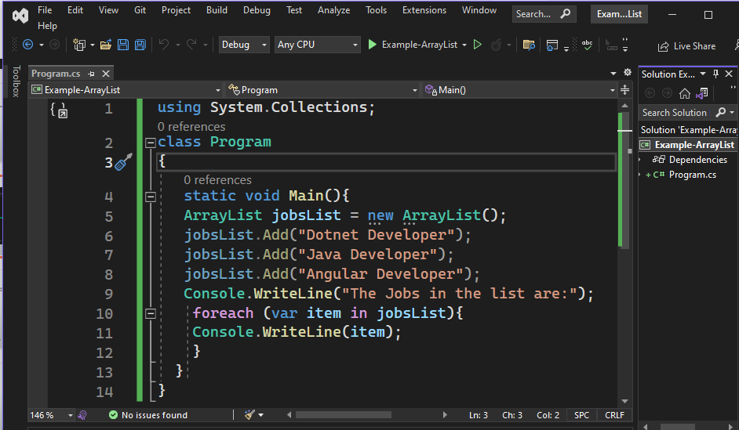
Example
Notes:
Example :
In this example First, we create an ArrayList – it's like an empty bag waiting to hold our job titles. We call it jobsList.
Now, we start adding jobs to our list using the Add method. It's like placing job titles into our bag. After adding the jobs, we want to see what's inside our bag. So, we use a loop to go through each job and print it out.
Finally, we run the program, It prints out the jobs we added to the list.

Slide 10

HASHTABLE
In C#, a Hashtable is a collection class that represents a collection of key-value pairs in which keys are unique and the values can be of any type.
It provides a fast way to store and retrieve data by using a hash table algorithm that maps keys to their corresponding values.
Notes:
Hashtable :
Let's explore another powerful tool in the world of collections in C# – the Hashtable.
In simple terms, a Hashtable is like a special container that holds pairs of things – a key and a value. Think of it like having a drawer full of keychains, where each keychain has a unique key, and you can attach any type of item to it.
The cool part? Keys are unique, meaning no two keychains are the same. It's like having a bunch of unique labels for your items in the drawer.
Now, why is this useful? Well, a Hashtable provides a lightning-fast way to store and retrieve data. It uses a smart algorithm called a hash table, which quickly maps keys to their corresponding values.

Slide 11
The Hashtable class is defined in the System.Collections namespace
It provides methods such as
Add
Remove
Contains
ContainsKey
ContainsValue
Count.
Notes:
The Hashtable class is defined in the System.Collections namespace . It provides methods such as add , remove, contains, containskey, containsvalue and count.

Slide 12
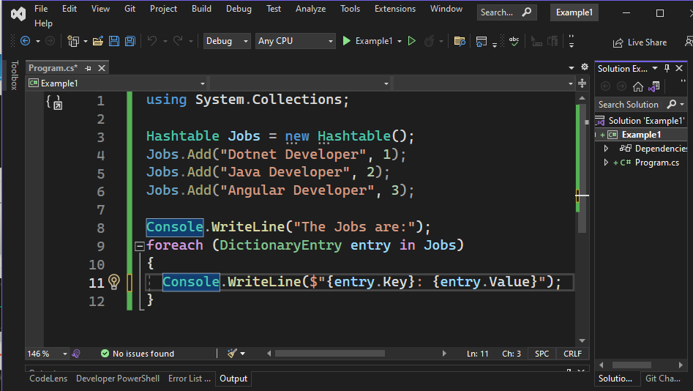
Example
Notes:
Example :
In this example, a Hashtable named 'jobs' is created to store key-value pairs, where job titles like "Dotnet Developer," "Java Developer," and "Angular Developer" are associated with corresponding numeric identifiers (1, 2, 3). The code then prints the message "The jobs are:" to the console. Subsequently, a foreach loop iterates through each key-value pair in the 'jobs' Hashtable, and for each entry, it retrieves and prints the job title and its numeric identifier. The result is a clear presentation of job titles alongside their respective identifiers, showcasing how Hashtables in C# efficiently manage and retrieve such paired data.

Slide 13

QUEUE
In C#, a Queue is a collection class that represents a first-in, first-out (FIFO) collection of objects.
It provides a way to store and retrieve objects in a "first in, first out" order, where the first object added is the first object to be removed.
Notes:
Queue :
Let's delve into another fascinating collection class in C# - the Queue.
In simple terms, a Queue is like a line of people waiting for something, and the first person to join is the first one to get served. It follows a "first-in, first-out" (FIFO) order.
Think of it like standing in line at your favorite ice cream shop – the first person in line gets their ice cream first. Similarly, a Queue allows us to store and retrieve objects in the same order they were added.
It's a handy way to manage tasks or items that need to be processed in a specific order.

Slide 14
The Queue class is defined in the System.Collections namespace
It provides methods such as
Enqueue
Dequeue,
Peek
Count.
Notes:
The Queue class is defined in the System.Collections namespace . It provides methods such as Enqueue , Dequeue, Peek and Count.

Slide 15
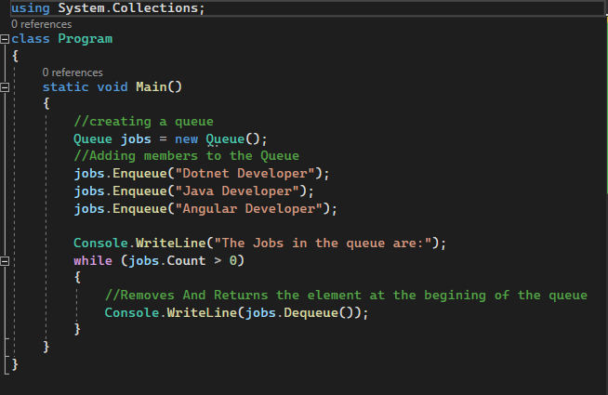
Example
Notes:
Example :
In this example, a Queue named 'jobs' is created to represent a collection of jobs following a "first-in, first-out" (FIFO) order. Three jobs, namely "Dotnet Developer," "Java Developer," and "Angular Developer," are added to the Queue using the Enqueue method. The program then prints the message "The jobs in the queue are:" to the console. Subsequently, a while loop is employed to dequeue and print each job in the Queue until the Queue is empty. This showcases how Queues efficiently manage and process tasks or items in the order they were added, akin to a digital waiting line where the first job added is the first one to be processed.

Slide 16

STACK
In C#, a Stack is a collection class that represents a last-in, first-out (LIFO) collection of objects.
It provides a way to store and retrieve objects in a "Last in, first out" order, where the first object added is the first object to be removed.
Notes:
Stack :
Now, let's dive into another fascinating collection class in C# - the Stack.
In simple terms, a Stack is like a stack of plates – the last plate you put on the stack is the first one you pick up. It follows a "last-in, first-out" (LIFO) order.
Imagine you're at a buffet, and as you pick up plates, you stack them one on top of the other. The last plate you pick up is the first one you use – it's a "last-in, first-out" scenario.
It provides a way to store and retrieve objects in the opposite order they were added.

Slide 17
The Stack class is defined in the System.Collections namespace
It provides methods such as
Push
Pop,
Peek
Count.
Contains
Notes:
The Stack class is defined in the System.Collections namespace . It provides methods such as Push, Pop, Peek, Count and Contains.

Slide 18
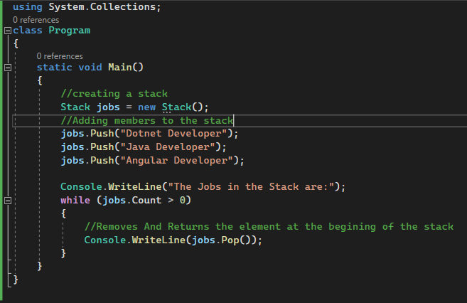
Example
Notes:
Example :
In this example, a Stack named 'jobs' is created to represent a last-in, first-out (LIFO) collection of jobs. Using the Push method, three jobs, including "Dotnet Developer," "Java Developer," and "Angular Developer," are added to the top of the stack. The program then prints the message "The jobs in the stack are:" to the console. Subsequently, a while loop is employed to pop and print each job from the stack until the stack is empty. This illustrates the fundamental principle of Stacks – the last job added is the first one processed. The code mirrors a digital stack of jobs, showcasing how Stacks efficiently manage and process tasks or items in a "last in, first out" order.

Slide 19

SORTED LIST
Sorted List is a collection class that represents a collection of key-value pairs sorted by key.
A key cannot be a null reference, but a value can be.
SortedList is a combination of the Array and the Hashtable.
A SortedList object automatically sort the items in alphabetic or numeric order.
It uses a binary search algorithm to locate elements quickly.
Notes:
Sorted List :
Now, let's uncover the SortedList, a unique collection class in C# that's all about order.
A SortedList is like having a collection of key-value pairs, but with a twist – it's automatically sorted by the keys.
Keys are like labels that help us organize things, and in a SortedList, they ensure our collection stays in alphabetic or numeric order. It's like having an organized shelf for your items.
One interesting thing is that a key cannot be a null reference, but a value can be. It's like saying every item must have a label, but it's okay if some items don't have additional details.
This SortedList is like a hybrid of an array and a Hashtable. It combines the indexing feature of an array with the sorting capabilities of a Hashtable. And here's the cool part – it uses a binary search algorithm to quickly find items.

Slide 20
The Sorted List class is defined in the System.Collections namespace
It provides methods such as
Add
Remove,
Contains key
IndexOfKey
IndexOfValue
Count
Notes:
The Sorted List class is defined in the System.Collections namespace . It provides methods such as Add, Remove, Contains key, IndexOfKey, IndexOfValue, Count.

Slide 21
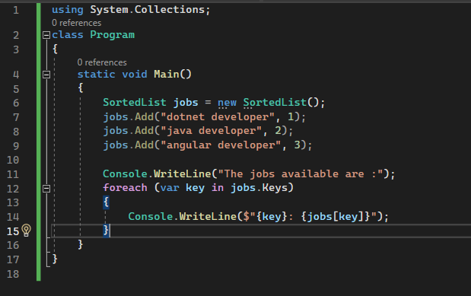
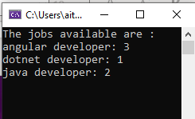
Example
Notes:
Example :
In this C# code snippet, a SortedList named 'jobs' is utilized to represent a collection of job titles sorted alphabetically. Job titles such as "Dotnet Developer," "Java Developer," and "Angular Developer" are added to the SortedList using the Add method. The program then prints the message "The jobs available are:" to the console. Subsequently, a foreach loop is employed to iterate through each key in the SortedList, retrieving and printing both the key (job title) and its corresponding value. This showcases the SortedList's automatic sorting based on keys, providing an organized and ordered presentation of job titles. It's like having an alphabetically sorted job list at your disposal, making it easy to access and display information in a structured manner.

Slide 22

Notes:
Thank you for joining this session.

